Slide 1
CASE STUDY – C APPLICATIONS SECURITY HARDENING
Carnegie Mellon Software Engineering Institute
https://wiki.sei.cmu.edu/confluence/display/seccode/SEI+CERT+Coding+Standards
https://wiki.sei.cmu.edu/confluence/display/c/SEI+CERT+C+Coding+Standard

Slide 2
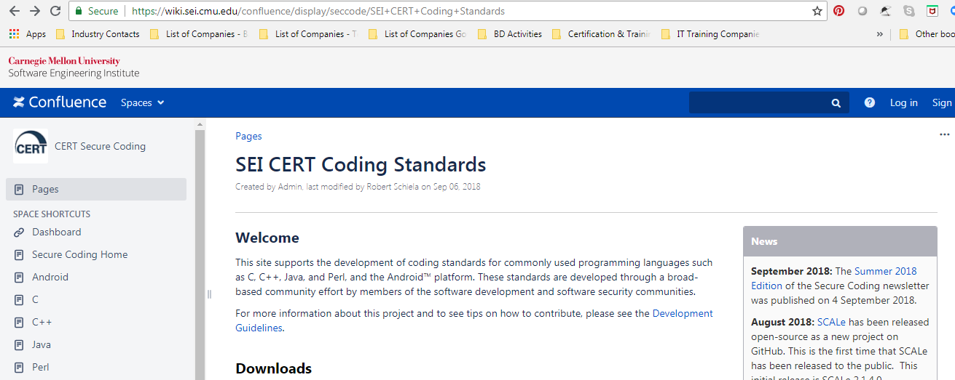
CASE STUDY – C APPLICATIONS SECURITY HARDENING
https://wiki.sei.cmu.edu/confluence/display/seccode/SEI+CERT+Coding+Standards

Slide 3
CASE STUDY – C APPLICATIONS SECURITY HARDENING
There are existing compiler implementations that allow const-qualified objects to be modified without generating a warning message.

Slide 4
CASE STUDY – C APPLICATIONS SECURITY HARDENING
Avoid casting away const qualification because doing so makes it possible to modify const-qualified objects without issuing diagnostics.

Slide 5
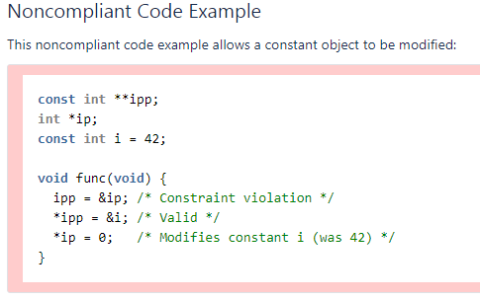
CASE STUDY – C APPLICATIONS SECURITY HARDENING

Slide 6
CASE STUDY – C APPLICATIONS SECURITY HARDENING
The first assignment is unsafe because it allows the code that follows it to attempt to change the value of the const object i.

Slide 7
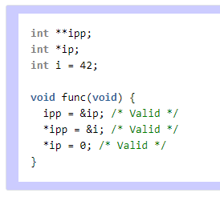
CASE STUDY – C APPLICATIONS SECURITY HARDENING

Slide 8
CASE STUDY – C APPLICATIONS SECURITY HARDENING
The compliant solution depends on the intent of the programmer. If the intent is that the value of i is modifiable, then it should not be declared as a constant, as in this compliant solution:

Slide 9
CASE STUDY – C APPLICATIONS SECURITY HARDENING
If the intent is that the value of i is not meant to change, then do not write noncompliant code that attempts to modify it.
Risk Assessment
Automated detection
Related vulnerabilities
END

